Slide 1

Impacts of Nutrition Change in the U.S
Source: USDA’s Agricultural Research Service and Food Data Central
Team 29 - United States Naval Academy
Emma Dear, Seungjae Hong, Matt Jao, Aaron Song

Slide 2
Agenda
02 The Questions
01 Background
03 Results and Analysis
04 Solutions

Slide 3
Introduction
Obesity is the leading cause of death in the United States
A Leading killer in America
Obesity is also linked to lower income and food insecurity
“Poverty-Obesity” Paradox
Given the FF and SR data, nutrient content in different food groups have changed over time
Food Analysis
Notes:
Given the dataset that we were assigned, a question that came to our minds was what was the biggest thing that makes nutrition so important to our everyday lives. So, today we would like to talk about a leading cause of death in the United States, which is obesity. We would like to talk about two things, that includes the Poverty-Obesity Paradox and Analysis on the FF and SR data

Slide 4
01
The USDA, Food, and Income
Notes:
According to the USDA, poor nutrition is a leading cause of illness in the United States, associated with more than half a million deaths per year. It is linked with increased risk of obesity, diabetes, and heart disease as well as broader impacts including higher health care costs and decreased productivity. The Beltsville Human Nutrition Research Center aims their research at at understanding the relationship between eating decisions coupled with insults (excess calories, viruses, bacteria, and environment pollutants) on the quality of life and overall health as a function of age, gender, and ethnicity for U.S. citizens.
Source:
https://www.usda.gov/nutrition-security
https://www.ars.usda.gov/northeast-area/beltsville-md-bhnrc/beltsville-human-nutrition-research-center/

Slide 5
United States Department of Agriculture
Poor Nutrition is a leading cause of illness in the United States
Poor nutrition is leading to higher rates of obesity in the United States
Ensure healthier, more prosperous future for ALL Americans
Nutrition Security
The Problem
Goals
Notes:
According to the USDA, poor nutrition is a leading cause of illness in the U.S which eventually leads to higher rates in obesity which is the main problem. As for overall goals, the USDA wants to ensure a healthier, more prosperous future for all americans

Slide 6
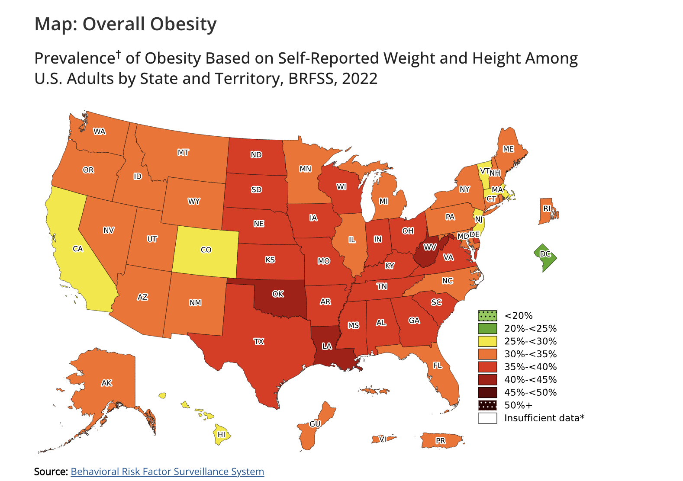
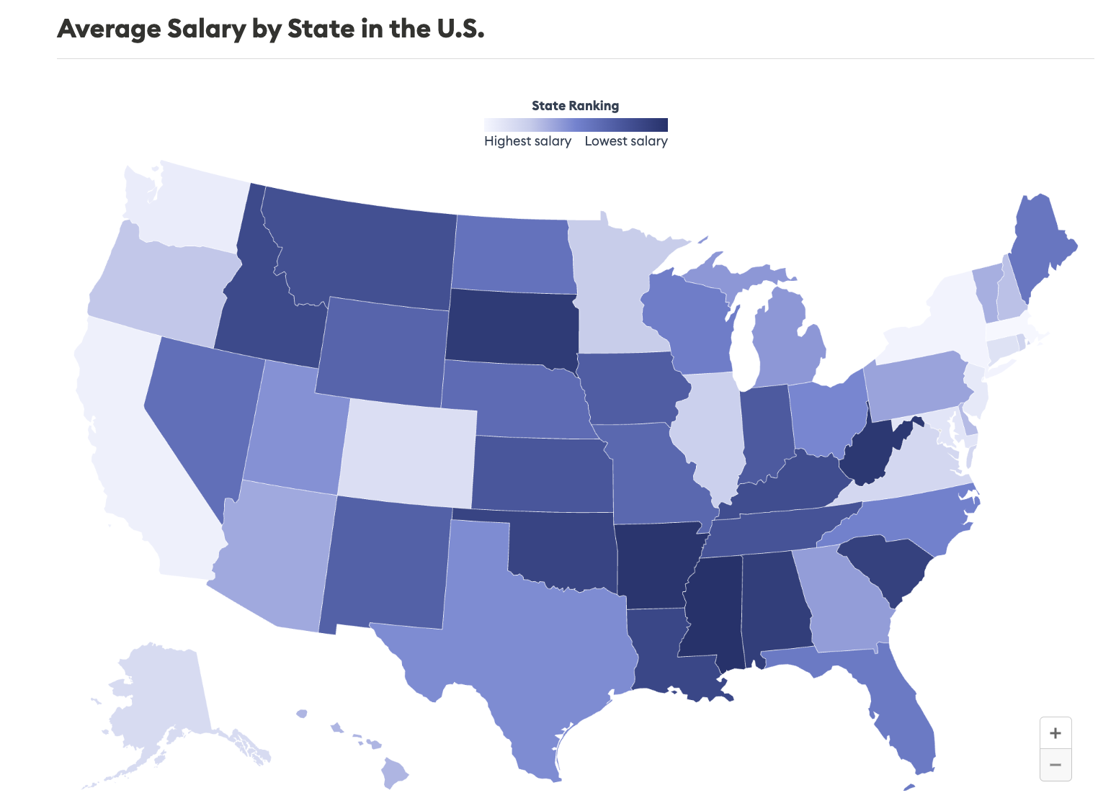
2024
Source: Bureau of Labor Statistics
Notes:
(General graphics for statistics in the United States) Based on the map above on the left, we can point out people in rural communities have higher rates of obesity compared to those living in urban and suburban areas. As we can see from the graph on the right, there is a correlation between areas of lower income and areas with high obesity prevalence. (To explain this association, I researched some studies on the poverty-obesity paradox) According to a study done by the CDC, the obesity prevalence rate has increased by 11.4% in the past 25 years from 30.5% to 41.9%. People with obesity are more prone to heart disease, stroke, and certain types of cancer which are among the leading causes of preventable, premature death. Additionally, the annual medical cost of obesity in 2019 was approximately $173 billion with medical costs for adults with obesity, on average, $1861 higher than medical costs for people with healthy weight. According to the National Institutes of Health, obese individuals have high rates of micronutrient deficiencies that play a key role in glucose metabolism and insulin signaling pathways. A large part of this is because of the increased availability of low-cost, high-calorie, nutrient-poor foods and modern agriculture and food processing techniques that lead to a reduction in micronutrient content of common foods. In the October 2009 version of Nutrition Reviews, a monthly medical journal published by Oxford University Press, a study pointed towards a deficiency in 6 major micronutrients associated with obesity: vitamin A, vitamin D, B-complex vitamins, calcium, iron, and zinc.
Sources:
https://www.cdc.gov/obesity/data/adult.html
https://www.cdc.gov/obesity/data/prevalence-maps.html
https://www.forbes.com/advisor/business/average-salary-by-state/
Olga P García, Kurt Z Long, Jorge L Rosado, Impact of micronutrient deficiencies on obesity, Nutrition Reviews, Volume 67, Issue 10, 1 October 2009, Pages 559–572,
https://doi.org/10.1111/j.1753-4887.2009.00228.x

Slide 7
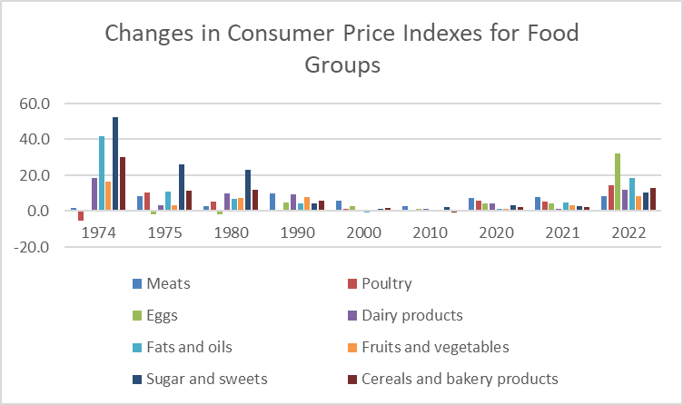
Changes In Food Prices
60%
Meticulous
100%
Proactive
Jupiter is a gas giant and the biggest planet in the Solar System
Mercury is the closest planet to the Sun and the smallest one
Notes:
(Graph of the change in food price over different years for certain food groups) Since 2000, the steady rise in food prices in America has paralleled an increase in obesity rates. This continuous rise in food cost has been a major reason for the increased obesity rate in every state from 2010 to 2022. However, there was a dramatic inflation in food price from 2021-2022, largely due to COVID-19, the war in Ukraine, and other challenges. Food prices generally increased about 11% from 2021-2022. Fruits and vegetables increased about 9%, dairy products increased 12%, meats, poultry, and fish increased about 12%, and grains increased by 13%. During this time period, obesity prevalence spiked with 41 states reporting obesity rates above 30%. These dramatic shifts could explain the tendency to opt for cheap, nutrient-poor foods, particularly among residents of lower-income areas.
(Consumer Price Index: a measurement of the variation in prices paid by typical consumers for retail goods and other items)
Sources:
https://www.gao.gov/blog/sticker-shock-grocery-store-inflation-wasnt-only-reason-food-prices-increased
Possible Sources:
https://www.medicalnewstoday.com/articles/obesity-and-poverty#is-poverty-linked-to-obesity
https://www.hsph.harvard.edu/obesity-prevention-source/obesity-prevention/food-environment/

Slide 8
Top 6 nutrients
Vitamin A
Calcium
Vitamin B
Zinc
Vitamin D
Iron
Notes:
Given the dataset that we were assigned, a question that came to our minds was what was the biggest thing that makes nutrition so important to our everyday lives. So, today we would like to talk about a leading cause of death in the United States, which is obesity. We would like to talk about two things, that includes the Poverty-Obesity Paradox and Analysis on the FF and SR data

Slide 9
02 Guiding Questions
How does the FF and SR data change across the years for each food group?
Does a change in obesity-mitigating nutrients correlate with obesity rates in the U.S.?
Does lower income correlate with reduced availability of nutritionally dense foods?
Notes:
Talking about obesities, According to Multidisciplinary Digital Publishing Institute (MDPI) reports the main factors that affect obesity is Vitamin A,B,D, Zinc, Calcium, Iron deficiency. So, our data analysis would be focused on given 6 nutrients.
FF data - Foundation food data (2019-2023)
SR data - SR legacy food data
To figure out the data change we would be comparing Average amount per 100g of edible portion of Foundation Food and SR legacy data by food categories in 6 given nutrients affects obesity.
Used bash command to strip down the data so we could make a graph
And unified the unit for better comparison, in this case we unified to gram(g).

Slide 10
03
Data Analysis

Slide 11
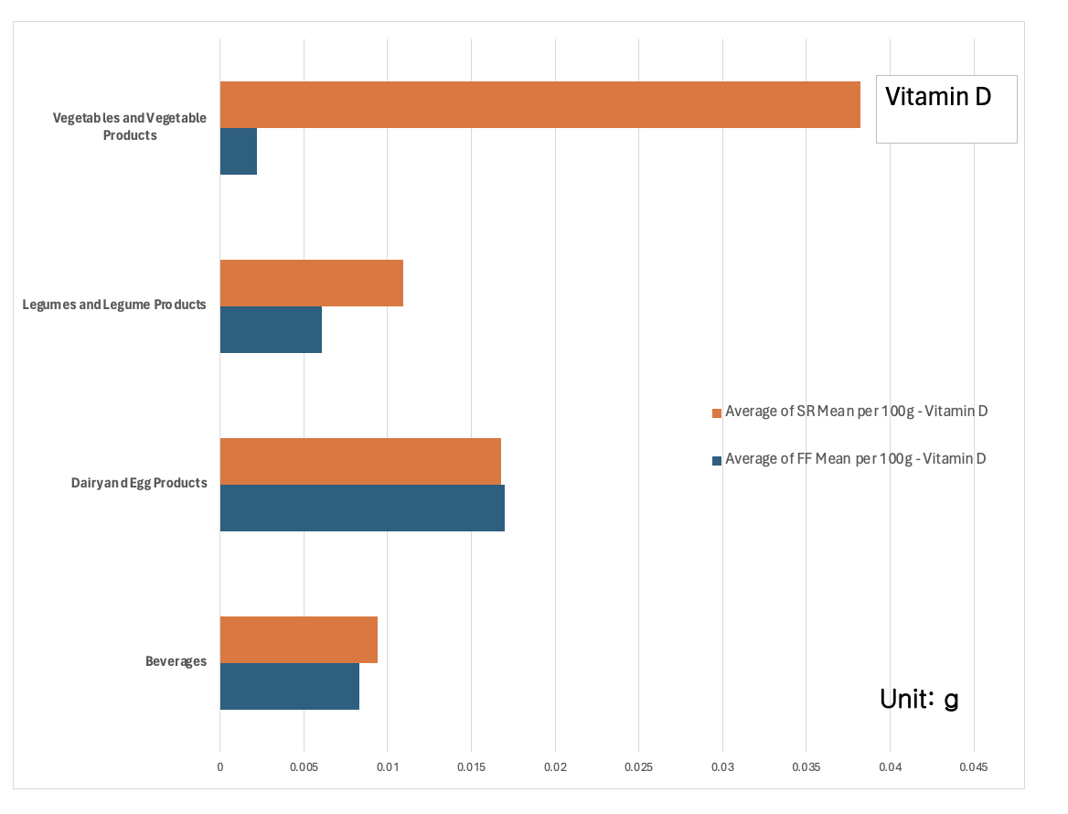
Notes:
Orange is the SR legacy data (old)
Blue is FF data (new)
For Vitamin A and Vitamin D, both nutrients decreased significant amount in category vegetables and vegetables product.

Slide 12
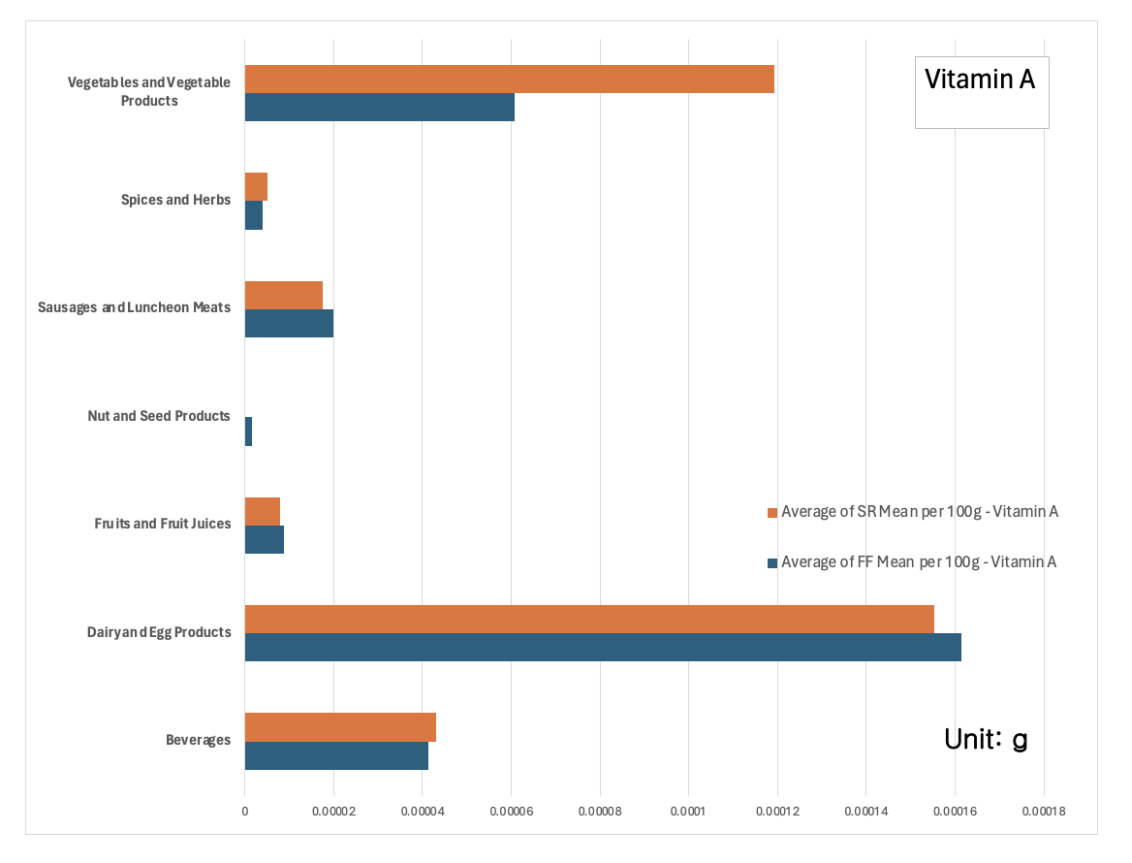

Slide 13
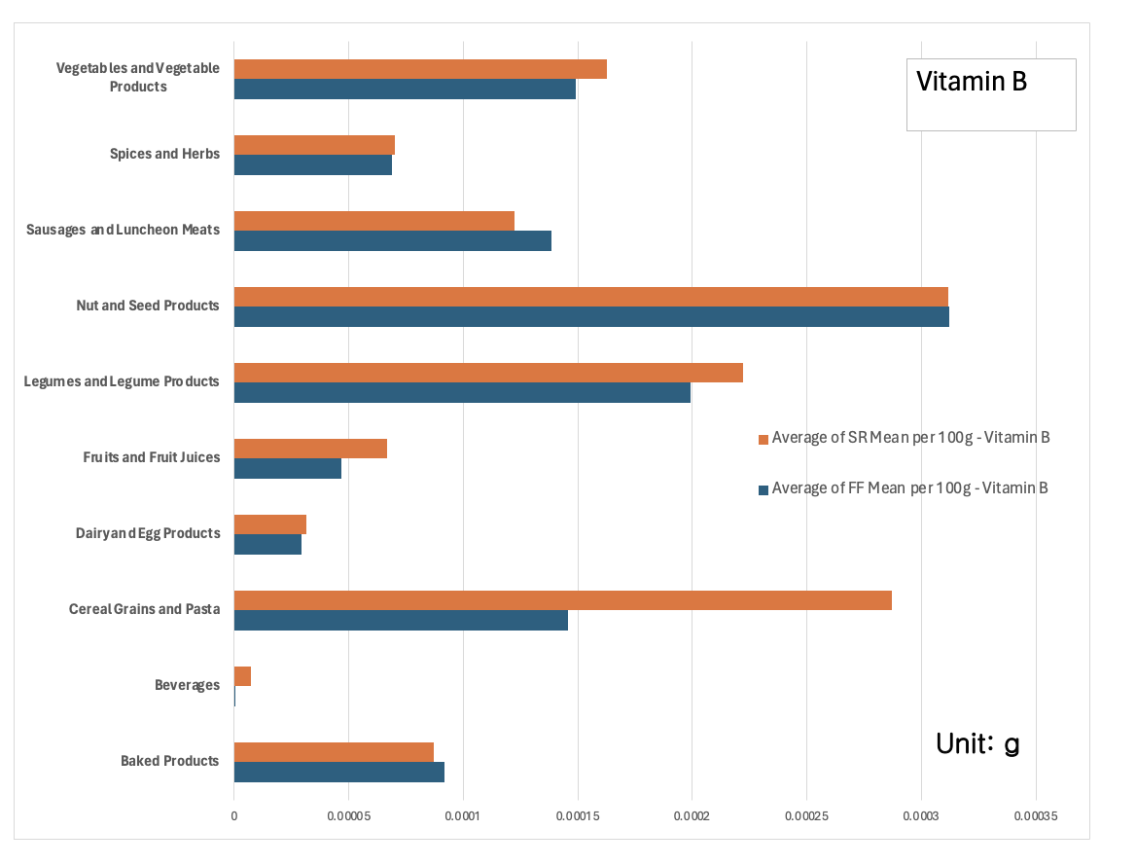

Slide 14
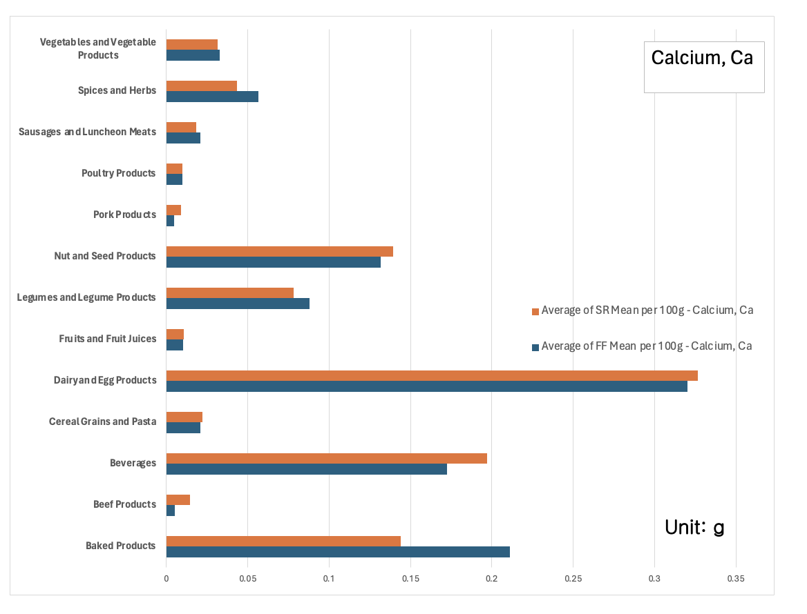

Slide 15
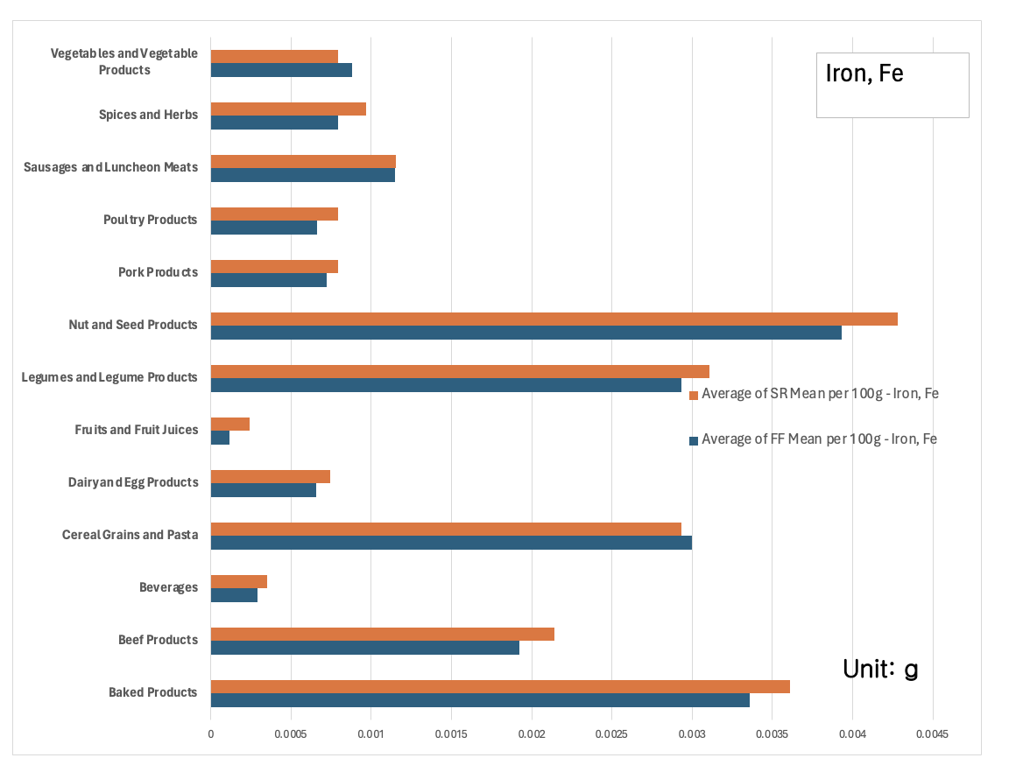
Notes:
One reason for the difference in nutrient content of certain food groups over different years involves the evolving agricultural processes and methods used to farm have caused a decline in the quantity of nutrients in crops over the past decades. The use of genetically modified seeds, synthetic fertilizers, and pesticides have increased crop yields but ultimately disturb soil health and reduce the absorption of nutrients from the soil, causing common foods to have a lower nutrient content compared to the past.
Source:
https://www.nationalgeographic.co.uk/environment-and-conservation/2022/05/fruits-and-vegetables-are-less-nutritious-than-they-used-to-be

Slide 16
Analysis
The Data
Correlations
Nutrients
Significant changes between the SR and FF data
Decrease in obesity-mitigating nutrients correlate with an increase in obesity rates
Nutrient Content overall decreases from SR to FF data

Slide 17
04 Solutions
Monetary
Agricultural Practices
Reducing taxes on nutrient-dense, low-calorie foods or taxing high-calorie foods, i.e. sugary drink tax
Crop biofortification
Selective plant breeding
Limiting genetically modified seeds, pesticides, and synthetic fertilizers.

Slide 18
References
“Food and Nutrition Security,” U.S. Department of Agriculture, https://www.usda.gov/nutrition-security
“Beltsville Human Nutrition Research Center: Beltsville, MD,” U.S. Department of Agriculture Agricultural Research Service, https://www.ars.usda.gov/northeast-area/beltsville-md-bhnrc/beltsville-human-nutrition-research-center/
“Food price outlook,” U.S. Department of Agriculture Economic Research Service, https://www.ers.usda.gov/data-products/food-price-outlook/

Slide 19
Thank You!

